Slide 1
Edge Advanced Bootcamp
Shared Flows / Flow Hooks

Slide 2
Shared Flows
What is a shared flow?
Collection of policies and resources that can be re-used across API proxies
Can also be used by other shared flows
A shared flow :
Does not have an endpoint and cannot be invoked directly
It can only be used by an API proxy (or other shared flow) that is in the same organization, and deployed to the same environment as itself
Shared flows help code reuse and management, code consistency, shorten development time
Can be used for common operational flows such as authentication, logging, etc.
Two ways to invoke a shared flow from an API proxy:
using the Flow Callout policy
using a Flow hook

Slide 3
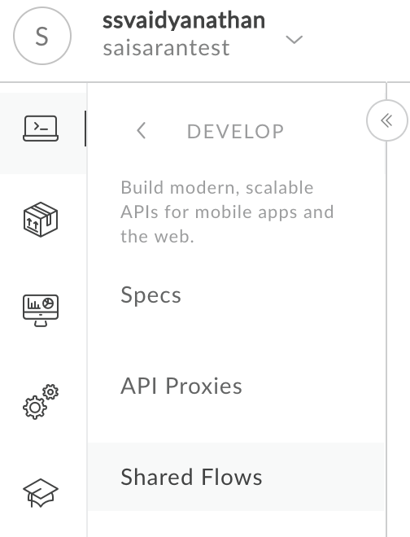
Developing a Shared Flow
Steps to develop a shared flow:
Determine what type of policies will make up the shared flow
Develop the flow , policies and resources
Optionally wrap the policies with conditions if needed
Deploy the shared flow to the environment before the API proxies (or other shared flows) that use it
Deploying a shared flow is the same as deploying an API proxy
<SharedFlow name="Basic_Security_Template">
<Step>
<Name>Verify-API-Key-1</Name>
</Step>
<Step>
<Name>Spike-Arrest-1</Name>
</Step>
<Step>
<Name>Quota-1</Name>
</Step>
</SharedFlow>

Slide 4
Flow Callout Policy
Add a FlowCallout policy to the API proxy (or shared flow) that will consume the shared flow
FlowCallout policy can be attached in Proxy or Target endpoints in request/response flows
References the shared flow using the SharedFlowBundle xml element in the policy
To test the shared flow, deploy the consuming API proxy (or shared flow) to the environment
<FlowCallout async="false" continueOnError="false" enabled="true" name="Flow-Callout-1">
<DisplayName>Flow Callout-1</DisplayName>
<FaultRules/>
<Properties/>
<SharedFlowBundle>Basic_Security_Template</SharedFlowBundle>
</FlowCallout>

Slide 5
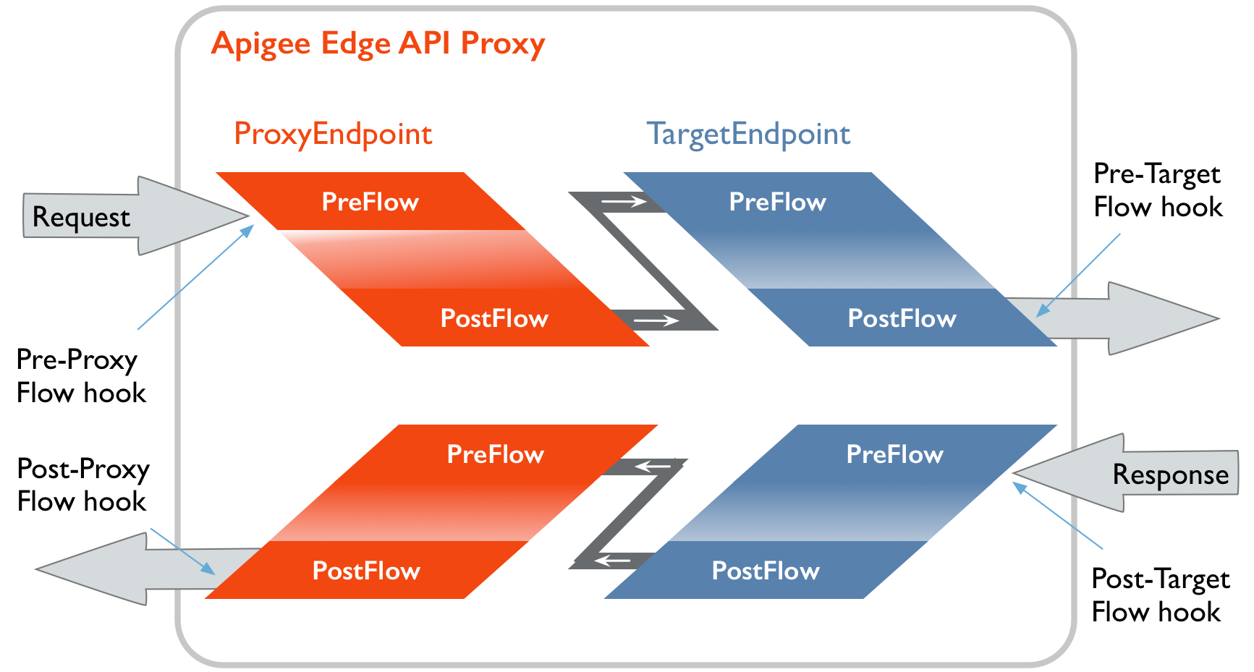
Flow Hooks
Using a flow hook, a shared flow can be attached and executed at the same point for all API proxies deployed to an environment
Administrator privileges are needed to create flow hooks
Only one shared flow can be attached to a flow hook
The same shared flow can be attached to more than one flow hook
Notes:
Using a flow hook, a shared flow can be attached and executed at the same point for all API proxies deployed to an environment
This way , common boilerplate processing can be achieved without modifying the API proxy logic
The common logic in the shared flow can be modified without impacting the API proxy
Administrator privileges are needed to create flow hooks
this is since shared flows attached via a flow hook impacts all API proxies in that environment
Flow hook attachment points:
Pre-proxy Request - logic executes before the proxy endpoint request
Pre-target Request - logic executes before the target endpoint request
Post-target Response - logic executes right after target response is received from the backend
Post-proxy Response - logic executes right after proxy endpoint and just before response is sent back to the client
Only one shared flow can be attached to a flow hook
The same shared flow can be attached to more than one flow hook

Slide 6
Flow Hooks
Flow Hook Location | Description
Pre-proxy Flow Hook | BEFORE a proxy endpoint executes
Pre-target Flow Hook | BEFORE a target endpoint executes
Post-target Flow Hook | AFTER the target response executes
Post-proxy Flow Hook | AFTER the proxy endpoint and right before the response is sent out to the client

Slide 7
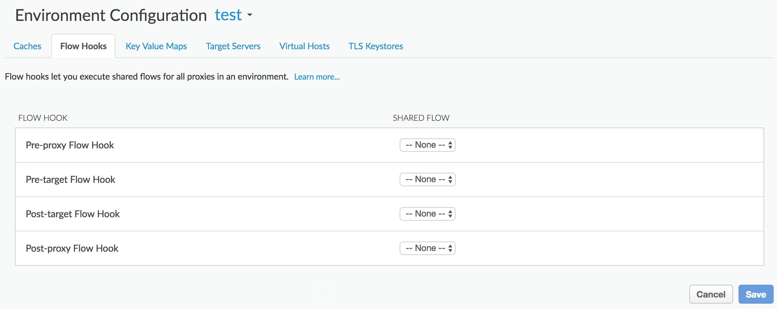
Attach a shared flow to a flow hook
Attach shared flows to flow hook in the Admin > Environment Configuration page
Identify the attachment point
Select the shared flow from the drop-down list (list shows deployed flows from the selected Env)
Save

Slide 8
THANK YOU

